Slide 1
Transmission Media

Slide 2
A transmission medium can be broadly defined as anything that can carry information from a source to a destination.
For example, the transmission medium for two people having a dinner conversation is the air.

Slide 3
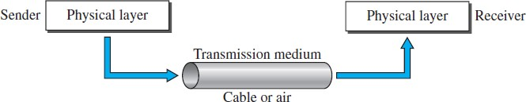

Slide 4
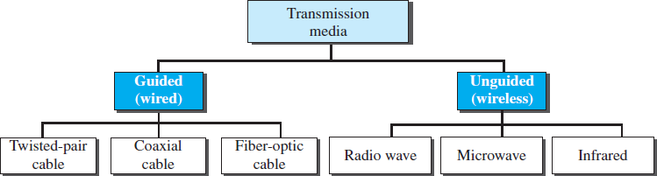
Classes of transmission media

Slide 5
Guided media, which are those that provide a conduit from one device to another.
Unguided media transport electromagnetic waves without using a physical conductor.
7.5

Slide 6
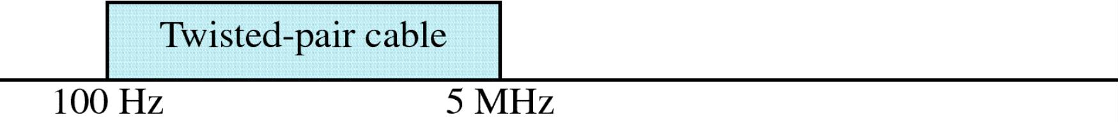
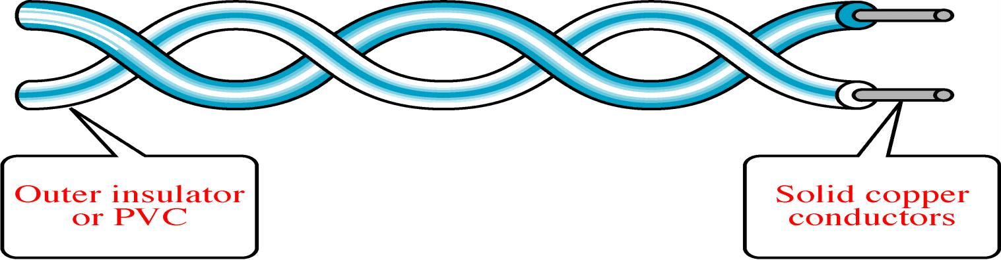
Twisted-Pair Cable
Twisted Pair and Coax use metallic(Copper) conductors that accept and transport the signals in the form of Electrical Current.

Slide 7
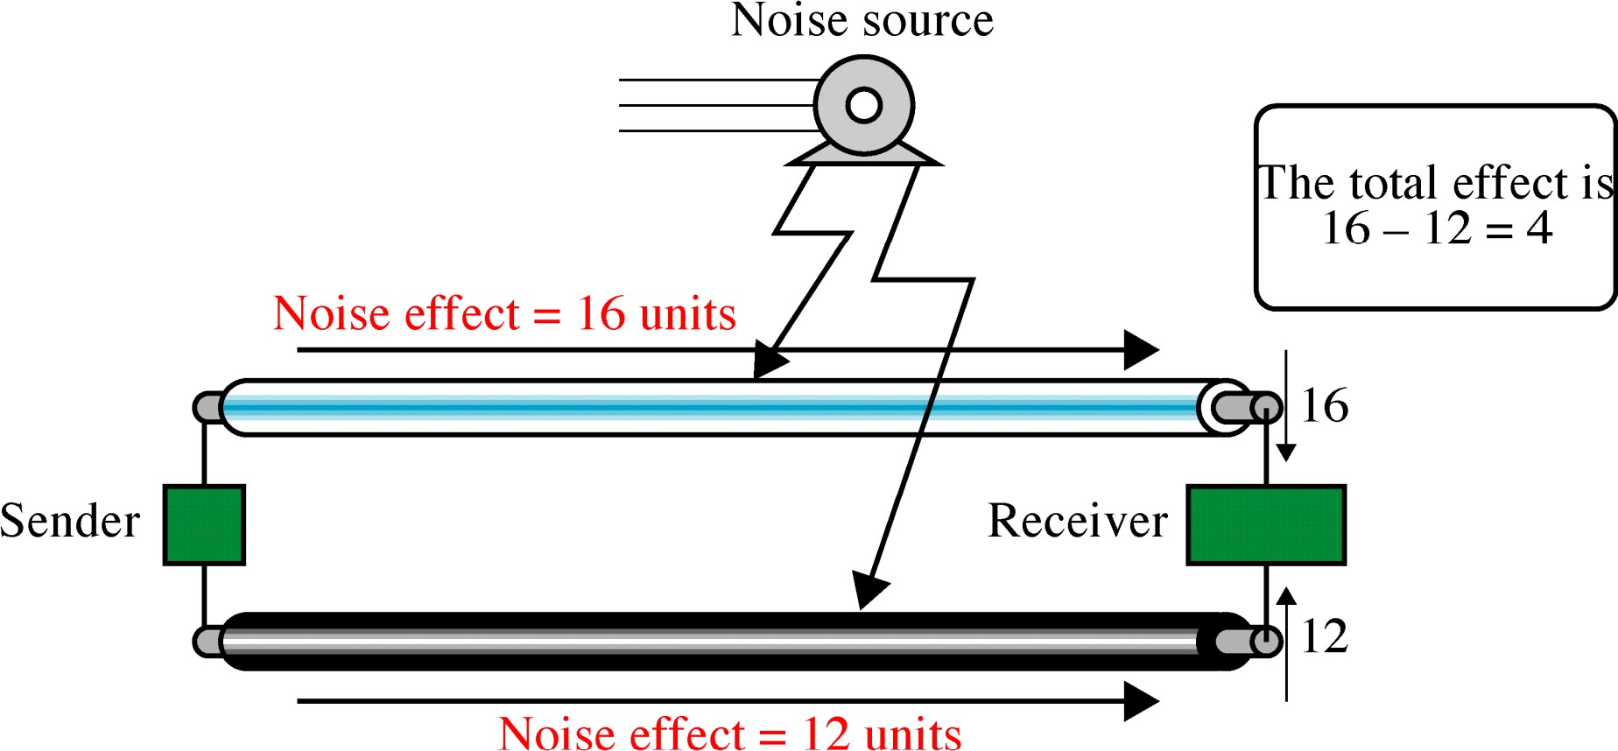
Effect of Noise on Parallel Lines

Slide 8
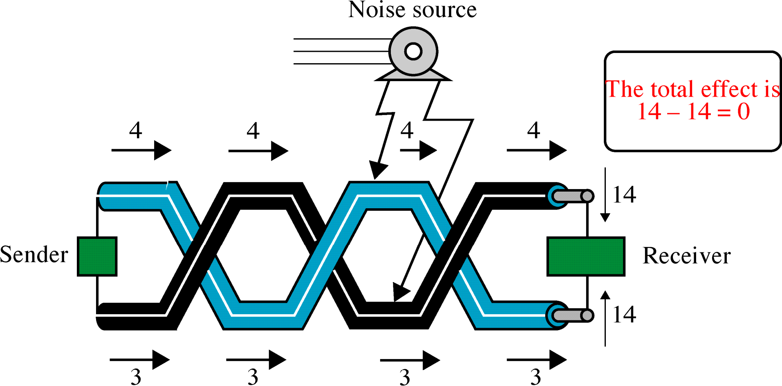
Noise on Twisted-Pair Lines

Slide 9
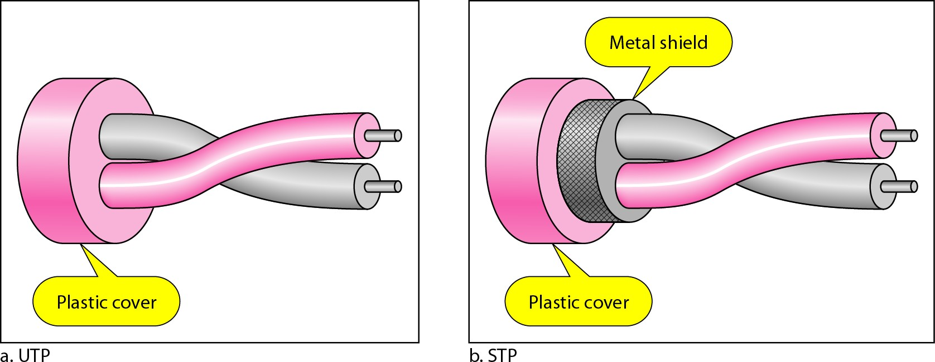
UTP and STP cables

Slide 10
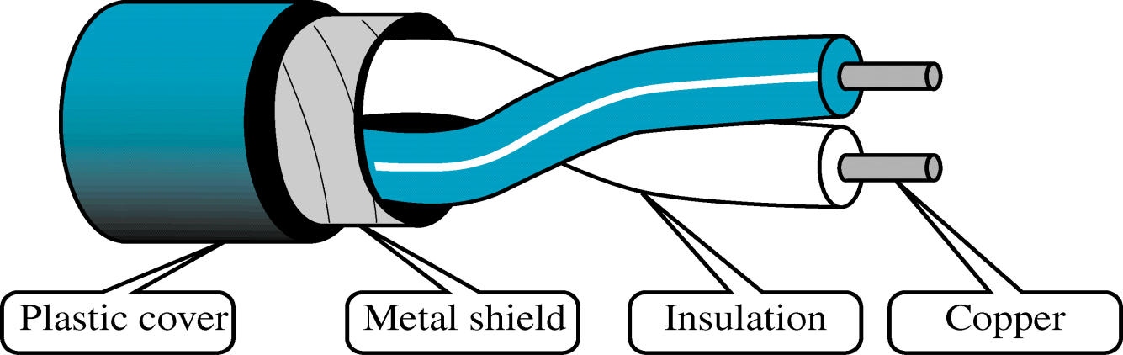
Shielded Twisted-Pair Cable
Metal casing prevents the penetration of electromagnetic noise.
Eliminate the phenomenon , called CROSSTALK

Slide 11
Advantages :
Cheaper
Less susceptible to electrical interference caused by nearby equipment or wires.
In turn are less likely to cause interference themselves.
Because it is electrically "cleaner", STP wire can carry data at a faster speed.
Disadvantages :
1. STP wire is that it is physically larger and more expensive than twisted pair wire.
7.11

Slide 12
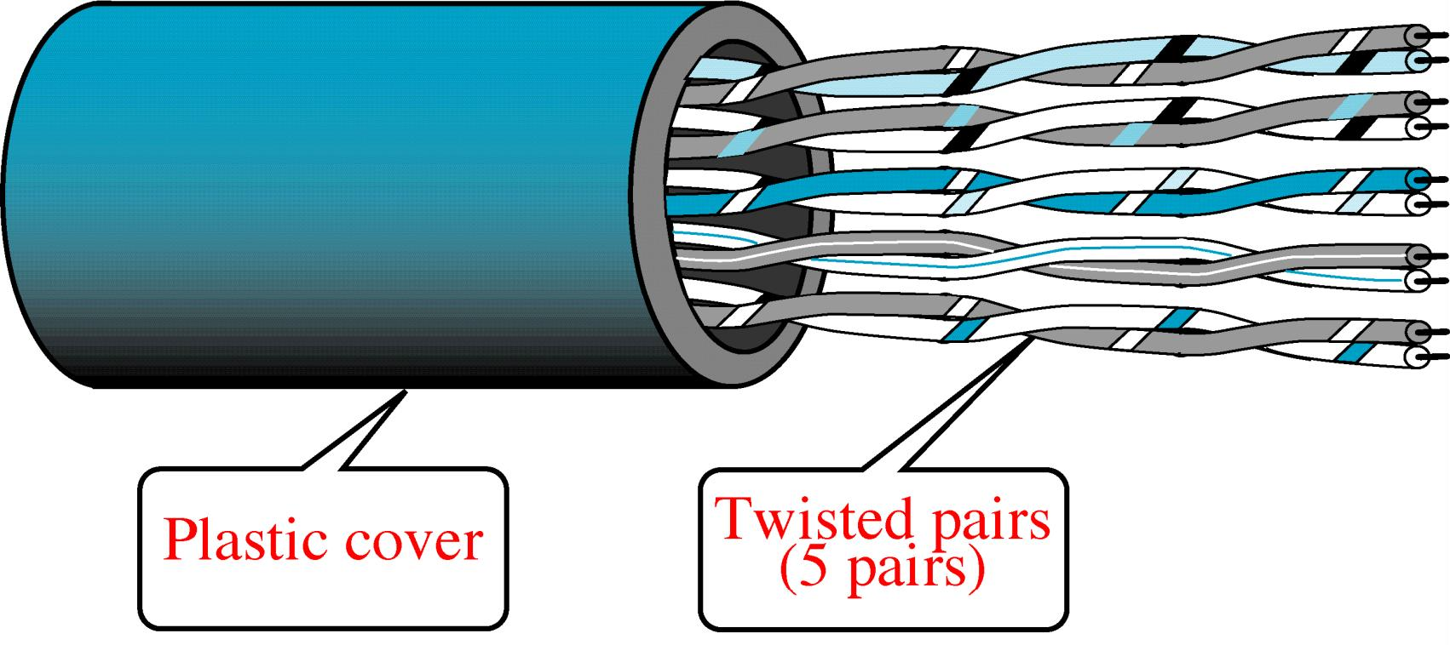
Unshielded Twisted-Pair Cable

Slide 13

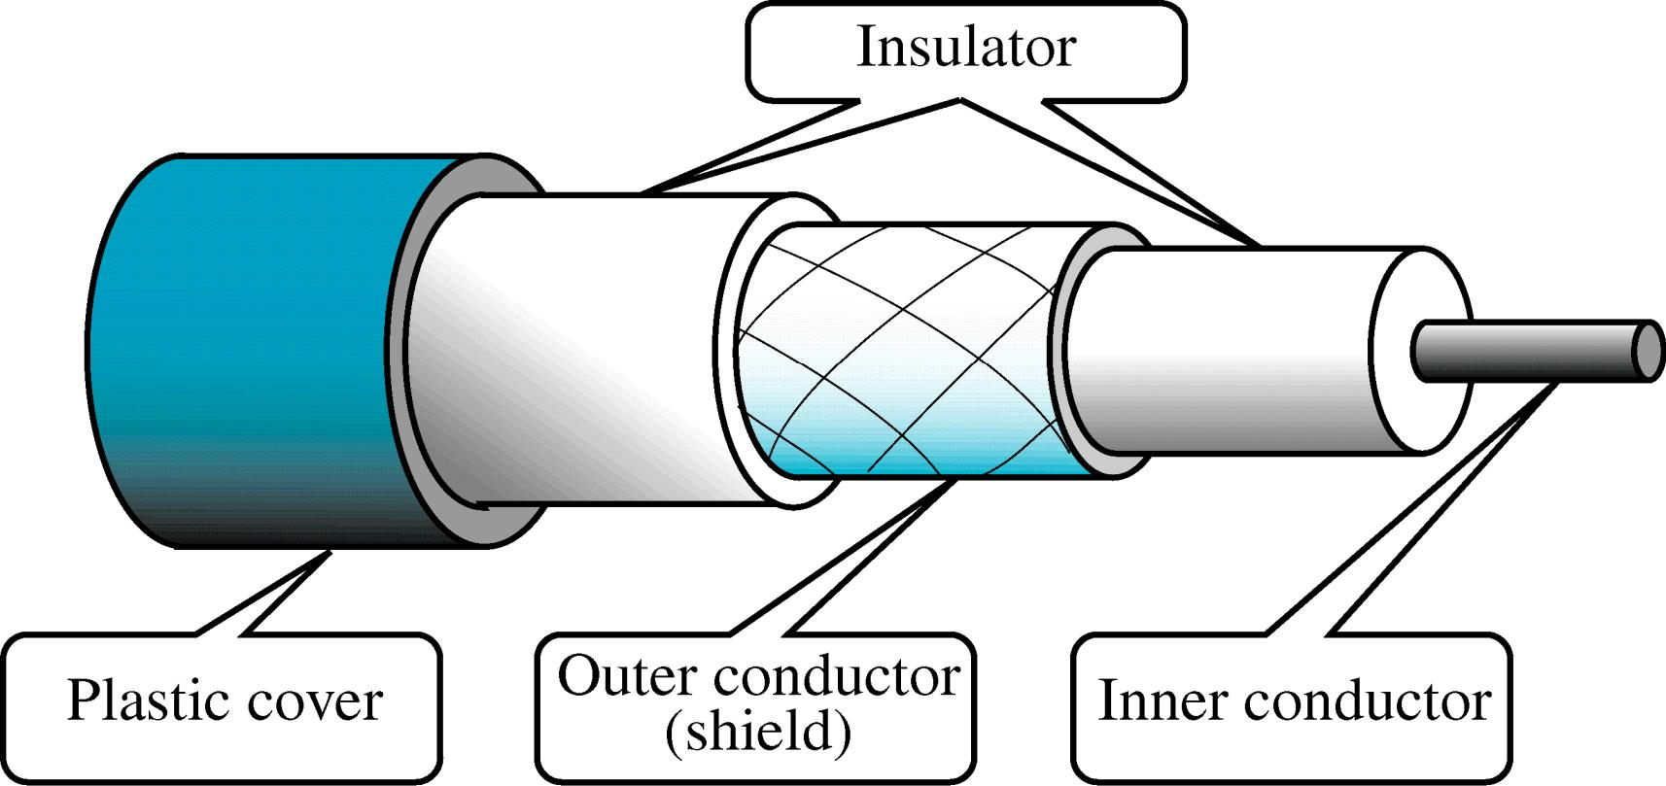
Coaxial Cable

Slide 14
Two kinds of coaxial cable
One kind, 50-ohm cable, is commonly used when it is intended for digital transmission from the start.
The other kind, 75-ohm cable, is commonly used for analog transmission and cable television.
Cable TV operators began to provide Internet access over cable, which has made 75-ohm cable more important for data communication.

Slide 15
High bandwidth
Excellent noise immunity.
The bandwidth possible depends on the cable quality and length.
Used within the telephone system, cable television and MAN
For long-distance lines, but have now replaced by fiber optics on
long distance routes.

Slide 16
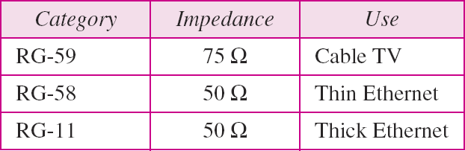
Categories of coaxial cables
7.16

Slide 17
Optical Fiber Cable
Optical Fiber is a glass or plastic cable that accept and transport the signals in the form of Light.
Advantages:
Noise Resistance
Less Signal Attenuation
Higher BW
Disadvantages:
Cost
Installation/Maintenance
Fragility(Broken Wire)

Slide 18
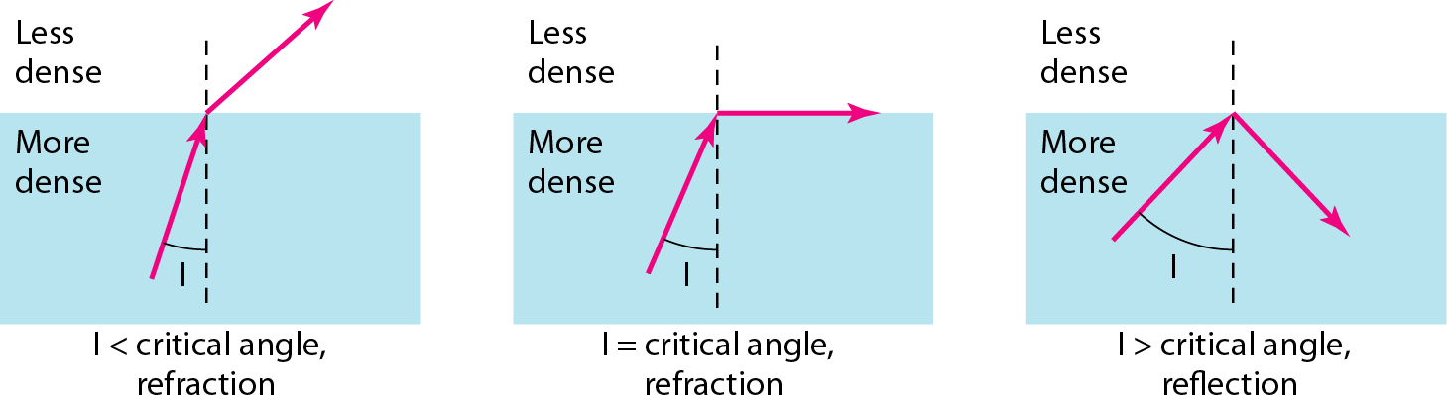

Slide 19
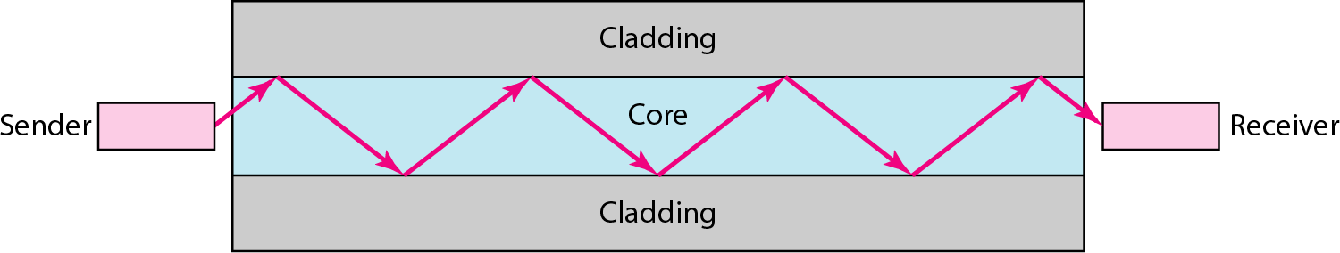
Optical fiber

Slide 20
























UNGUIDED MEDIA: WIRELESS
Unguided media transport electromagnetic
waves type of wireless
without using a communication communication.
physical is often
conductor. This referred to as

Slide 21
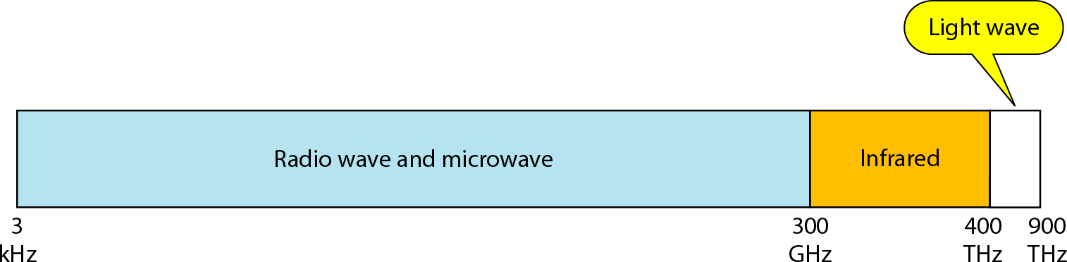
Electromagnetic spectrum for wireless communication

Slide 22
Propagation Methods
Ground Propagation
Sky Propagation
Line-of-Sight Propagation
7.22

Slide 23
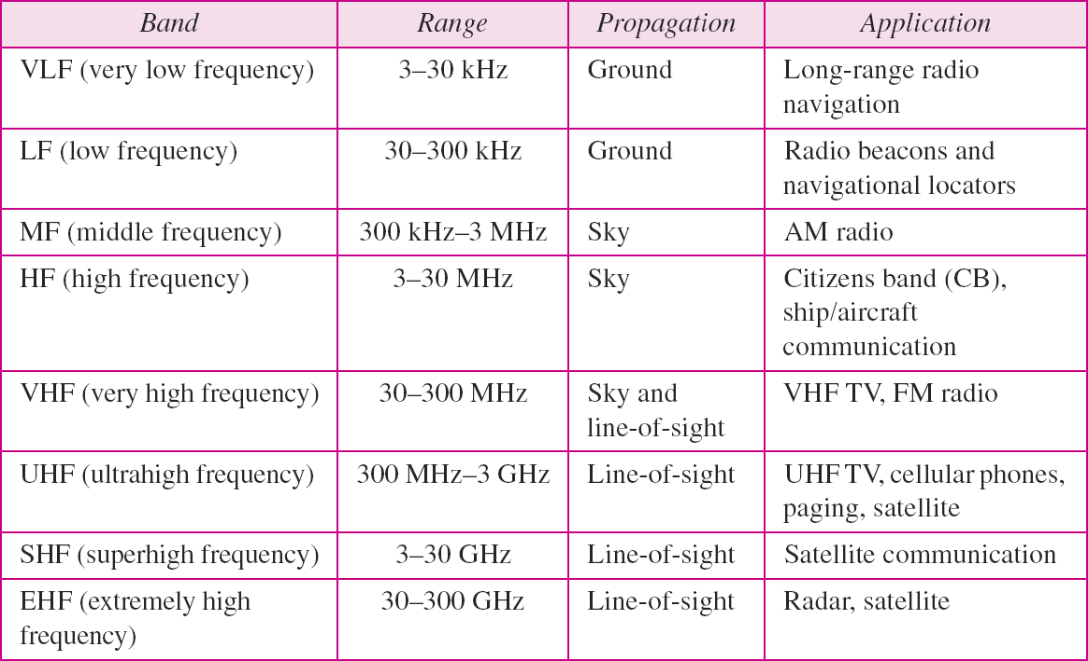
Bands

Slide 24
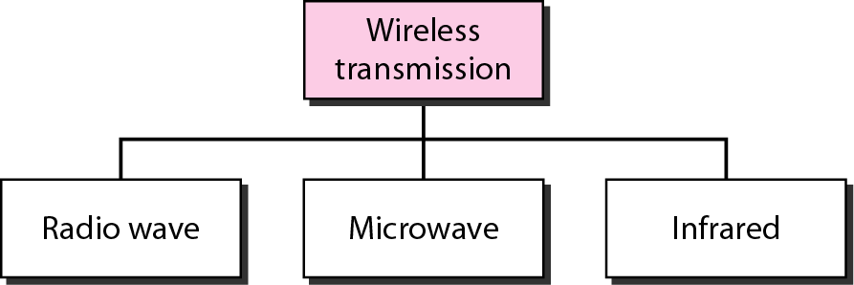
Wireless transmission waves

Slide 25




Note
Radio waves are used for multicast communications, such as radio and television.
They can penetrate through walls. Use Omni directional antennas

Slide 26
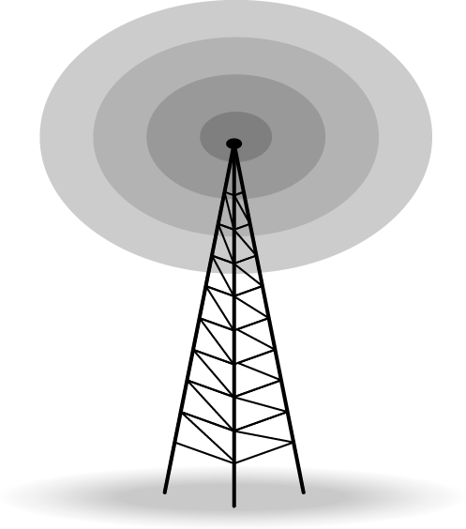
Omnidirectional antenna

Slide 27
Note
Microwaves are used for unicast communication such as cellular telephones and wireless LANs.
Higher frequency ranges cannot penetrate walls.
Use directional antennas - point to point line of sight communications.

Slide 28
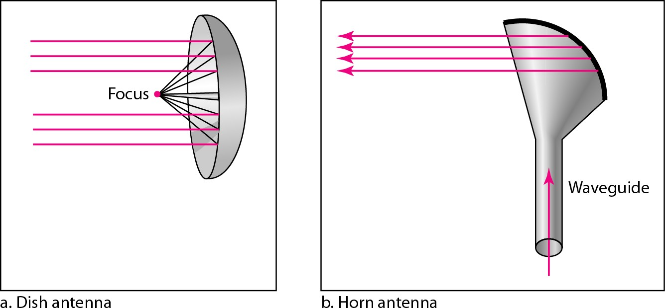
Unidirectional antennas

Slide 29
Note
Infrared signals can be used for short- range communication in a closed area using line-of-sight propagation.

Slide 30
Transmission Impairment
Signal transmit through medium that are not perfect.
This imperfection cause signal impairment.
What is sent is not received.

Slide 31
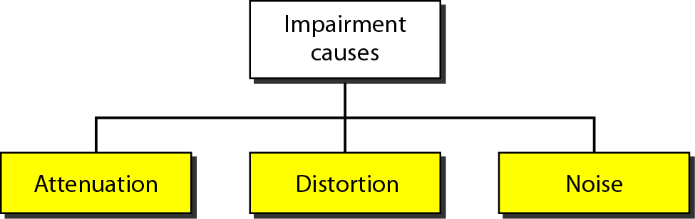
Causes of impairment

Slide 32
Attenuation
Means loss of energy -> weaker signal
When a signal travels through a medium it loses energy overcoming the resistance of the medium
Amplifiers are used to compensate for this loss of energy by amplifying the signal.

Slide 33
Measurement of Attenuation
To show the loss or gain of energy the unit “decibel” is used.
dB = 10log₁₀P₂/P₁ P₁ - input signal P₂ - output signal

Slide 34
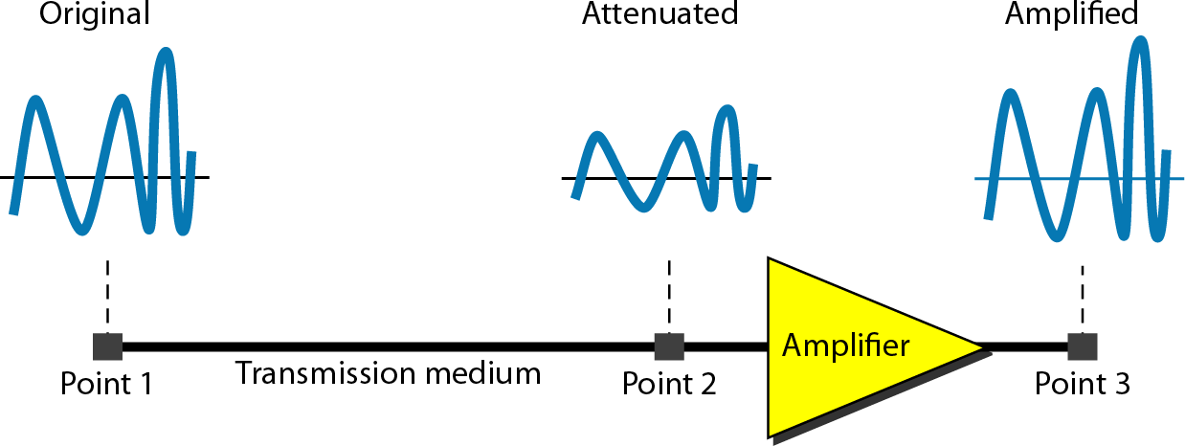
Attenuation

Slide 35
Suppose a signal travels through a transmission medium and its power is reduced to one-half. This means that P₂ is (1/2)P₁. In this case, the attenuation (loss of power) can be calculated as
7.35

Slide 36

Example 3.26
A loss of 3 dB (–3 dB) is equivalent to losing one-half the power.

Slide 37




Example 3.27
A signal travels through an amplifier, and its power is increased 10 times. This means that P₂ = 10P₁ . In this case, the amplification (gain of power) can be calculated as

Slide 38

Example 3.28
One reason that engineers use the decibel to measure the changes in the strength of a signal is that decibel numbers can be added (or subtracted) when we are measuring several points (cascading) instead of just two. In Figure 3.27 a signal travels from point 1 to point 4. In this case, the decibel value can be calculated as

Slide 39
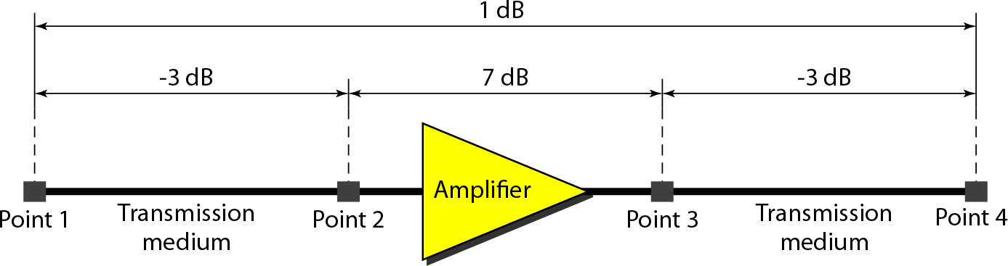
Decibels for Example 3.28

Slide 40
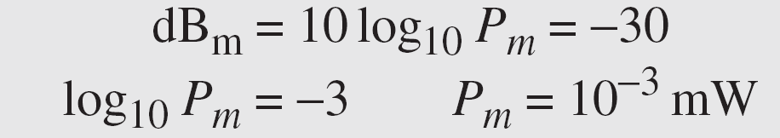
Example 3.29
Sometimes the decibel is used to measure signal power in milliwatts. In this case, it is referred to as dB_{m} and is calculated as dB_{m} = 10 log10 P_{m} , where P_{m} is the power in milliwatts. Calculate the power of a signal with dB_{m} =
−30.
Solution
We can calculate the power in the signal as

Slide 41
Distortion
Means that the signal changes its form or shape
Distortion occurs in composite signals
Each frequency component has its own propagation speed traveling through a medium.
The different components therefore arrive with different delays at the receiver.
That means that the signals have different phases at the receiver than they did at the source.

Slide 42
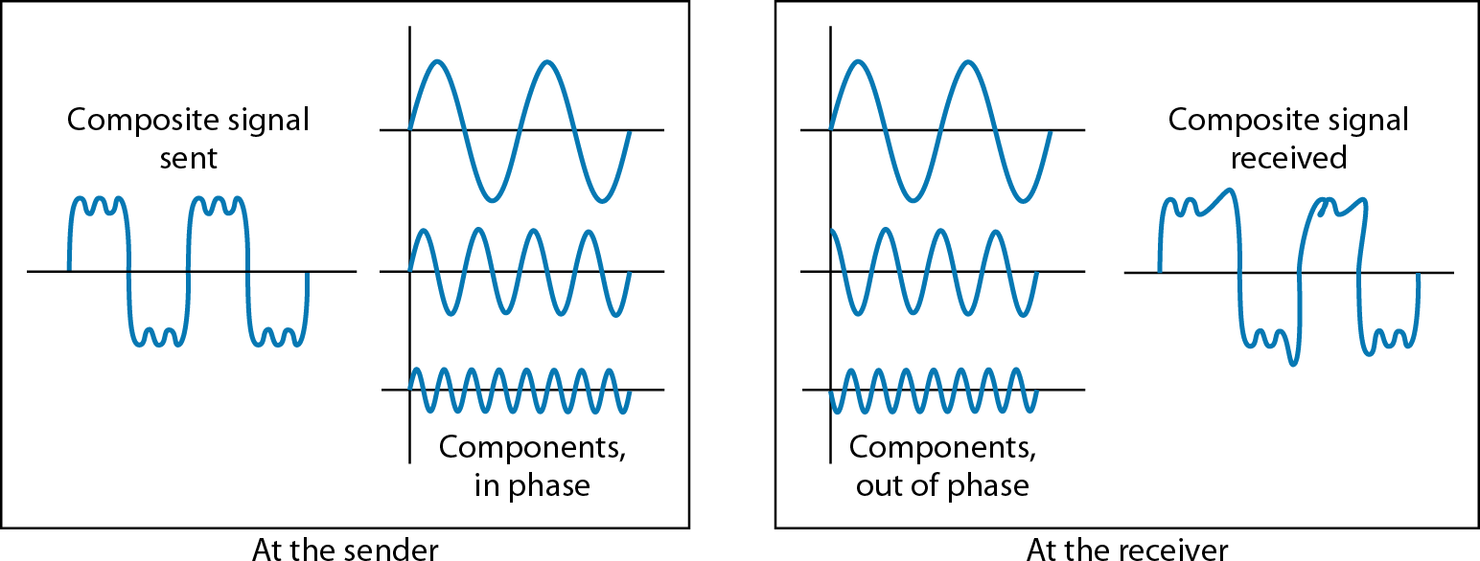
Distortion

Slide 43
Noise
There are different types of noise
Thermal - random noise of electrons in the wire creates an extra signal
Crosstalk - same as above but between two wires.
Impulse - Spikes that result from power lines, lightening, etc.
Induced

Slide 44
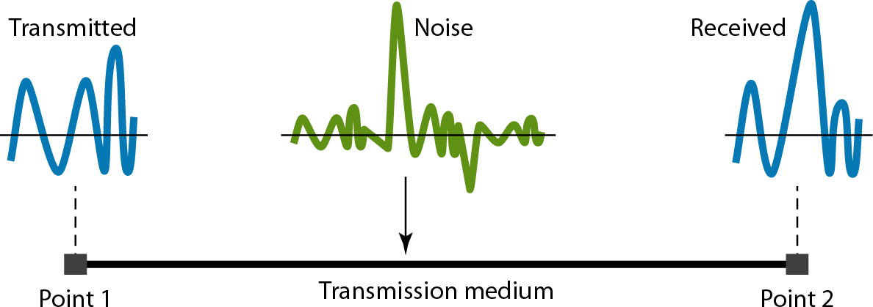
Noise

Slide 45
Signal to Noise Ratio (SNR)
To measure the quality of a system the SNR is often used. It indicates the strength of the signal wrt the noise power in the system.
It is the ratio between two powers.
It is usually given in dB and referred to as SNR_{dB.}

Slide 46
Example 3.31
The power of a signal is 10 mW and the power of the noise is 1 μW; what are the values of SNR and SNR_{dB} ?

Slide 47
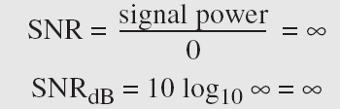
Example 3.32
The values of SNR and SNR_{dB} for a noiseless channel are
We can never achieve this ratio in real life; it is an ideal.

Slide 48
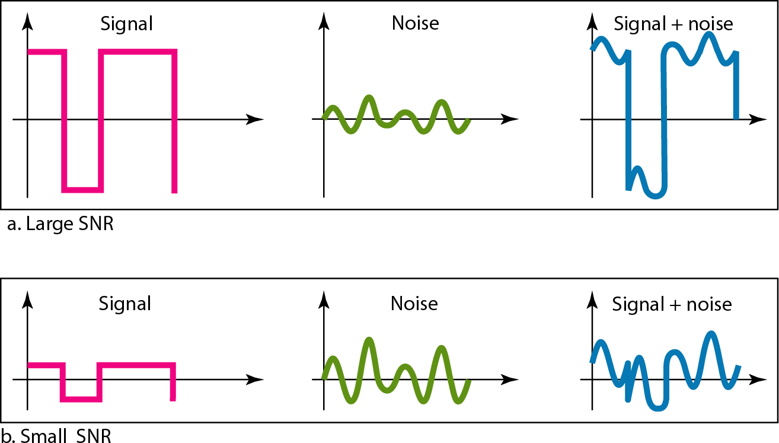
Figure 3.30 Two cases of SNR: a high SNR and a low SNR

